Slide 1



Unbreakable Pipeline on Azure DevOps
Patrick Thurner
Product Manager
Dynatrace
Gavin Hunter
Solution Engineer
Dynatrace
Safia Habib
Solutions Consultant
Dynatrace
Formerly VSTS

Slide 2
Agenda
Getting Started
Prevent in CI/CD vs Repair in Prod
Use cases where we can “Shift Left”
Self Healing with Azure Functions
Creating the Unbreakable Pipeline In Azure DevOps (Formerly – VSTS)
Workshop 1: Add a Build Pipeline into Azure DevOps
Workshop 2: Deploy VMs/OneAgent - Functions into Azure
Workshop 3: Configure SelfHealing Function in Dynatrace / Deploy Build 1
What is next – Remediation Use cases

Slide 3
Getting Started: Keep Your Azure DevOps Notes
VSTS URL | https://dev.azure.com/YourOrg
PAT ( Expires on April 3 2018)
Dynatrace_Tenant: | https://YourTenant.sprint.dynatracelabs.com
Dynatrace_Tenant_Token:
Dynatrace_API_TOKEN:
SelfHealing Function URL: | https://hotday-YourName-selfhealingfunction.azurewebsites.net
SelfHealing URL for Problem Notification | ?name=YourName
MonspecValidation Function URL | https://hotday-YourName-monspecvalidation.azurewebsites.net
UnbreakablePipelienGate Function URL: | https://hotday-YourName-monspecvalidation.azurewebsites.net/api/validatePerfSig
MonspecValidation Function Token:
Use this table to keep all necessary values necessary for the workshop
Copy this table and paste into a convenient place such as OneNote

Slide 4
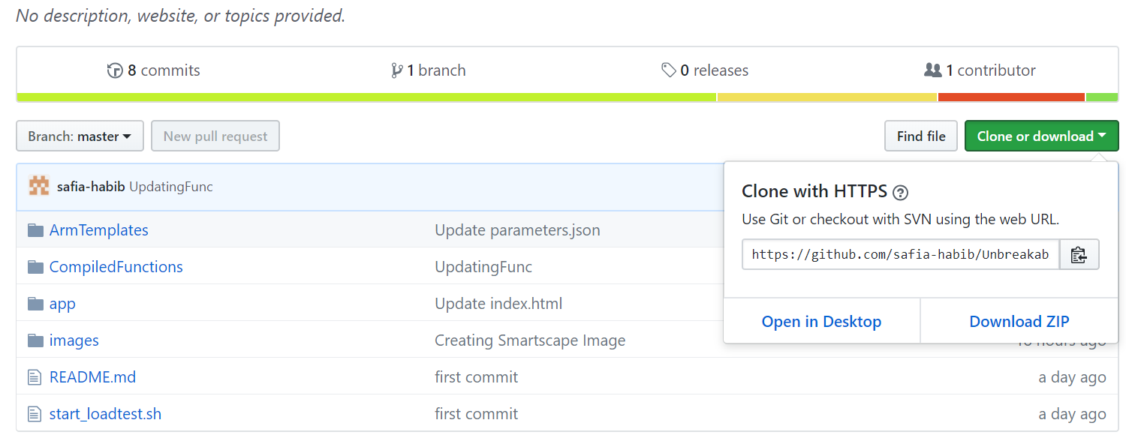
Getting Started: Download the GitHub Repository
https://github.com/safia-habib/UnbreakablePipelineAzureHOTDay

Slide 5
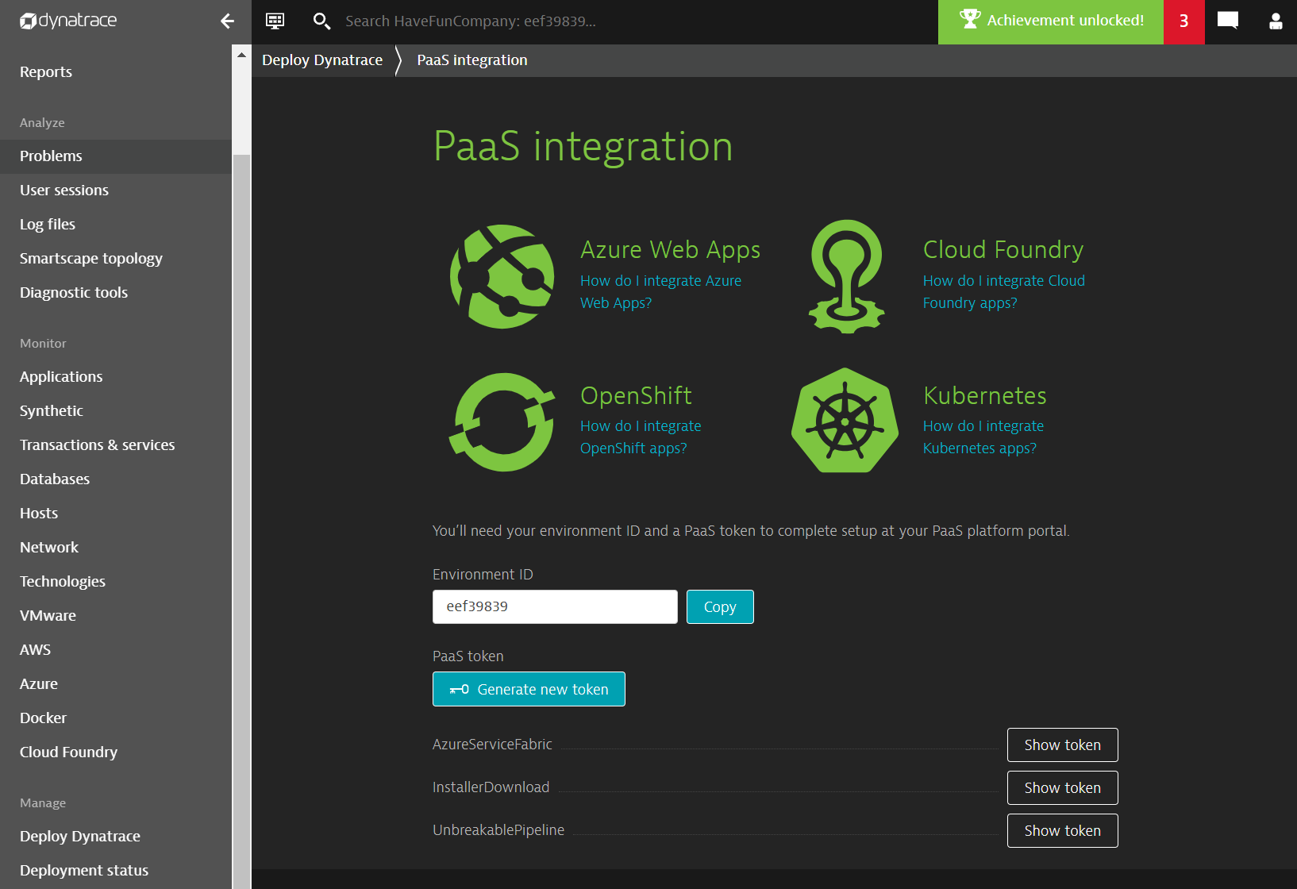
Getting Started: Getting Values from Dynatrace-step 1
Login to the Dynatrace account you have setup for this workshop
Go to Deploy Dynatrace->PaaS integration
Copy the Environment ID
Copy the URL : https://<tenant>.sprint.dynatracelabs.com
Generate and copy a new Token
Paste all of these values to your table

Slide 6
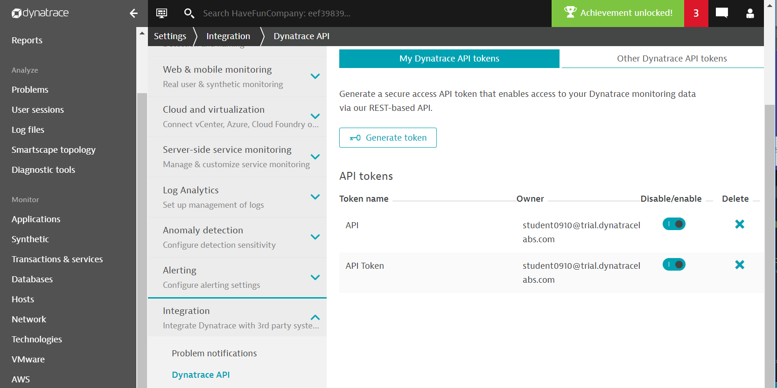
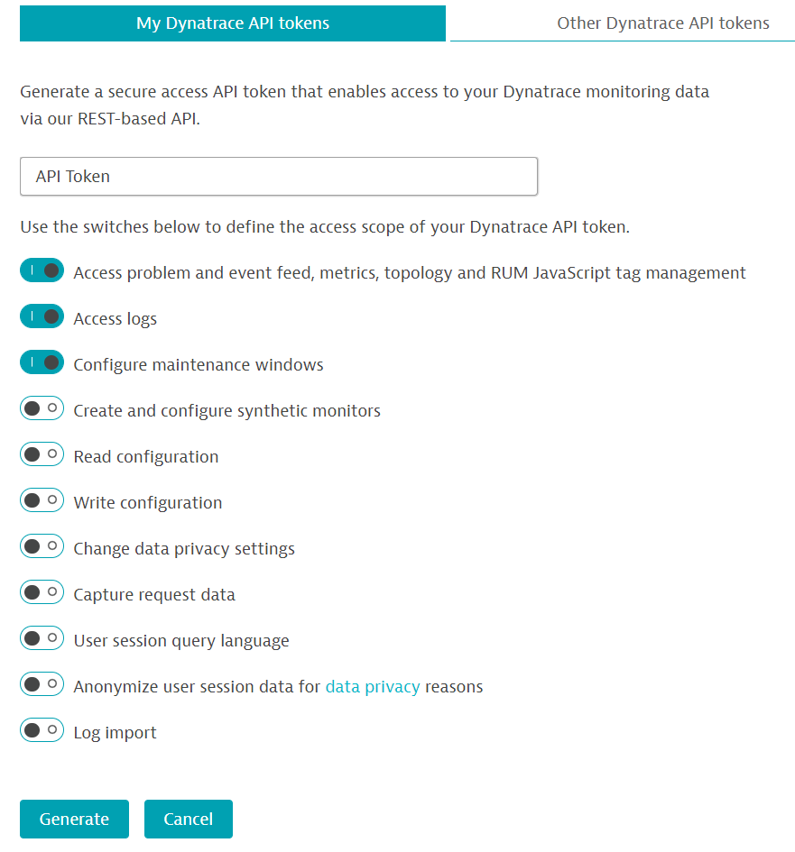
Getting Started: Getting Values from Dynatrace-step 2
3. Name it ‘API Token’
4. Hit ‘Generate’
5. Copy this token and paste it to your table
Go to Settings->Integration->Dynatrace API
From here choose ‘Generate Token’

Slide 7
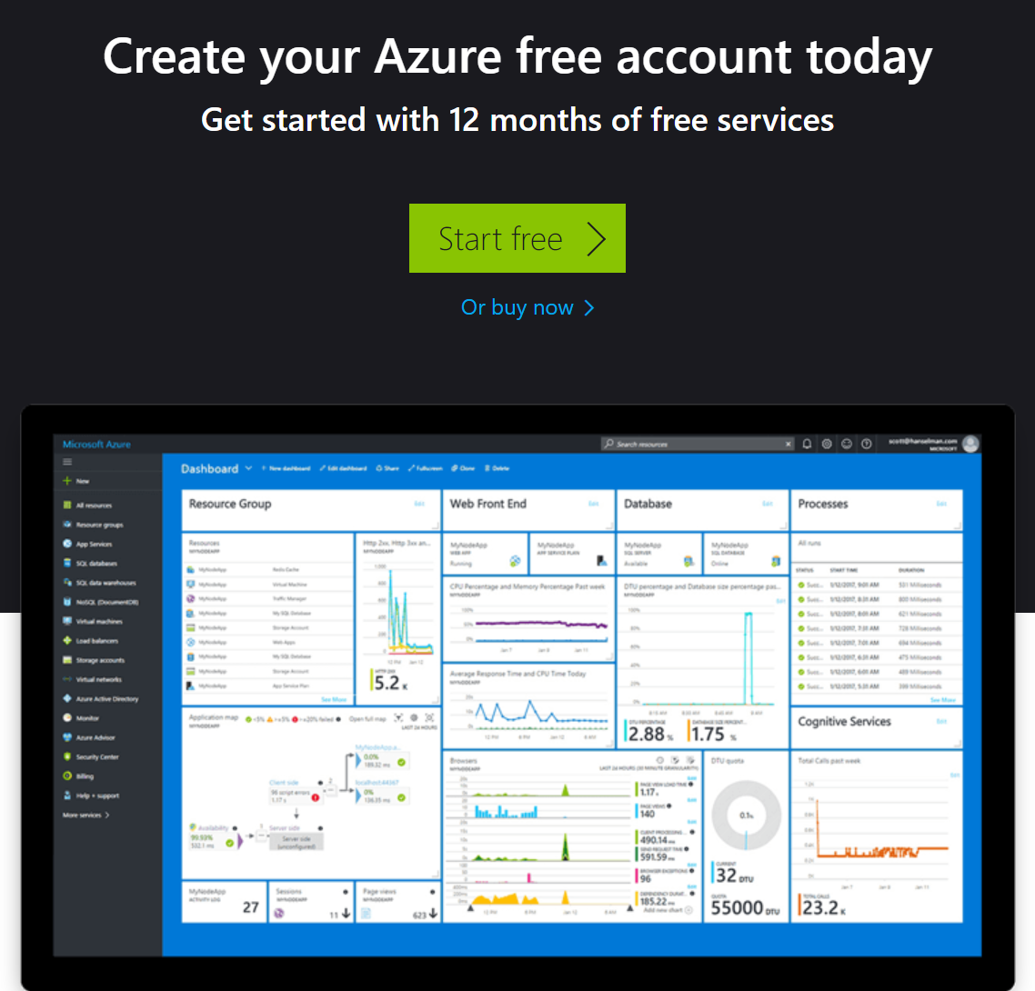
Getting Started: Signup for an Azure Account
Sign Up Here
https://azure.microsoft.com/en-us/free/search/?&OCID=AID719825_SEM_AvIozCH4&lnkd=Google_Azure_Brand&gclid=Cj0KCQiAp7DiBRDdARIsABIMfoDdEpeimNxnrSO64P05xcwbeYjxXK5Tx6HeWoXuVwXAvmX_3IljuX0aAnkNEALw_wcB

Slide 8
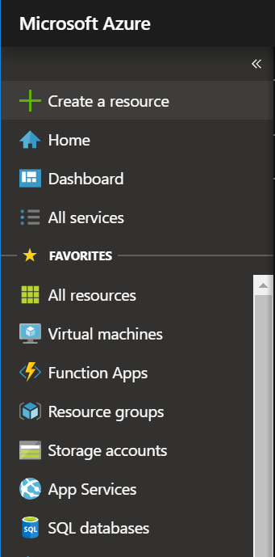
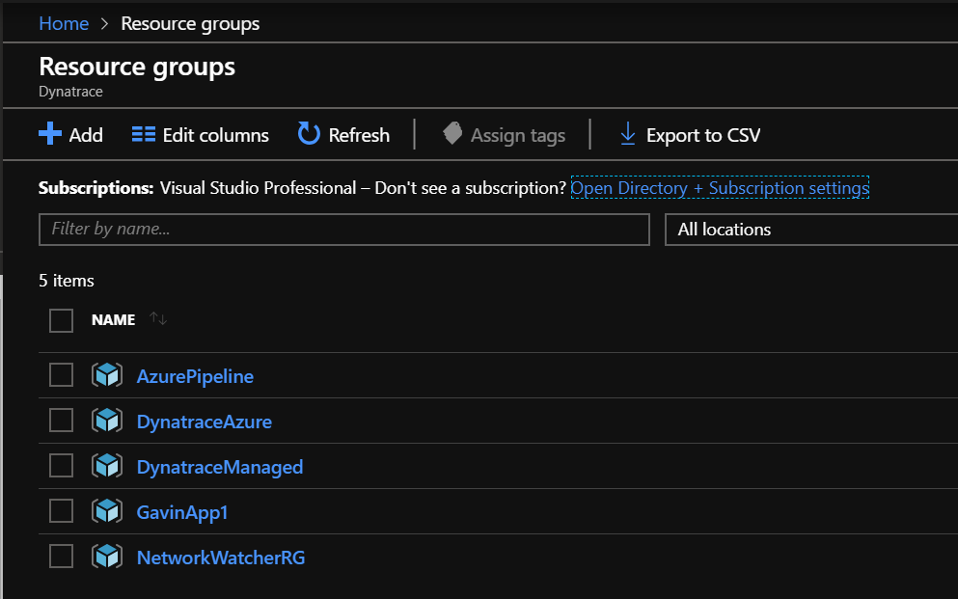
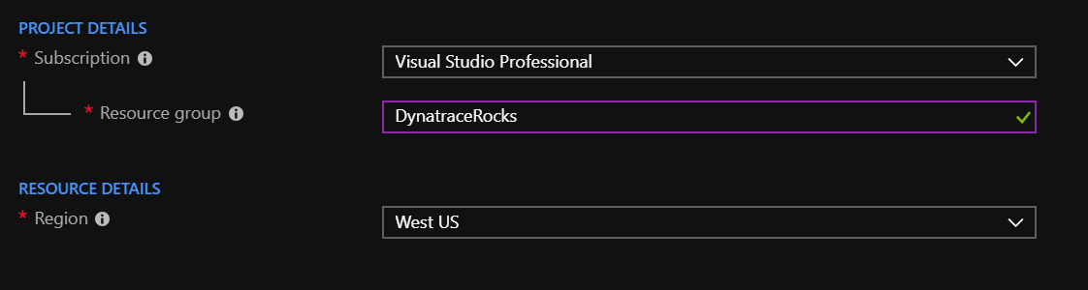
Getting Started: Create a ‘Resource Group’ in Azure
1. Log onto Azure and Add a Resource Group
2. Provide a name and Region for this Resource Group
3. Review and Create

Slide 9

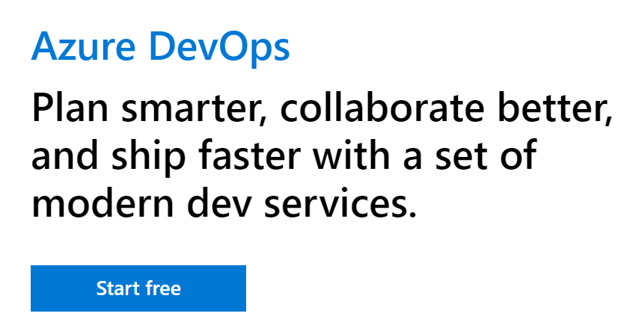
Getting Started: Sign up for an Azure DevOps Account
Sign Up Here
https://azure.microsoft.com/en-us/services/devops/?&OCID=AID736750_SEM_vjUFx1k5

Slide 10
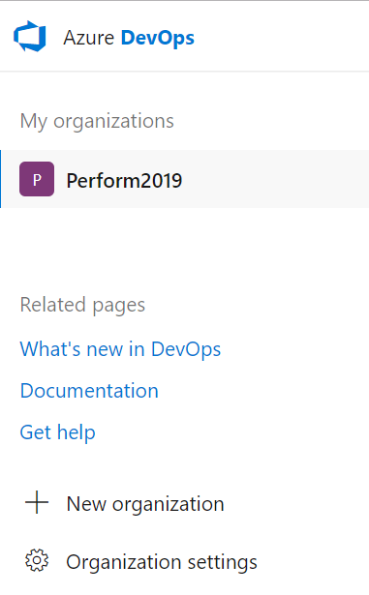
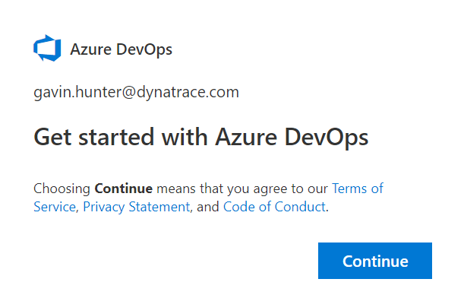
Getting Started: Create your DevOps Organization
Add a new organization to your DevOps account

Slide 11
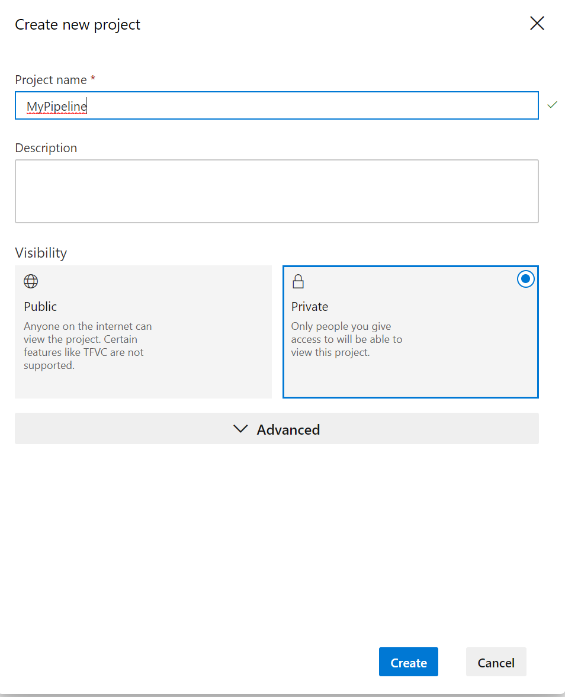
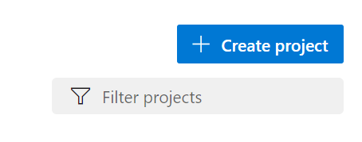
Getting Started: Create a DevOps Project
Provide a name for your Project
Select Private
Create

Slide 12
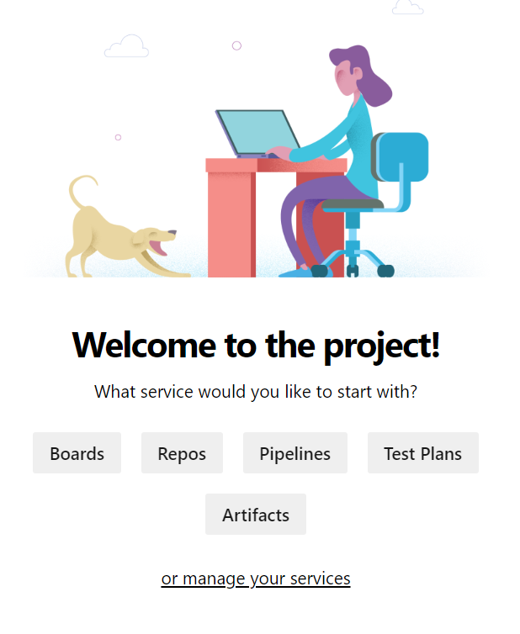
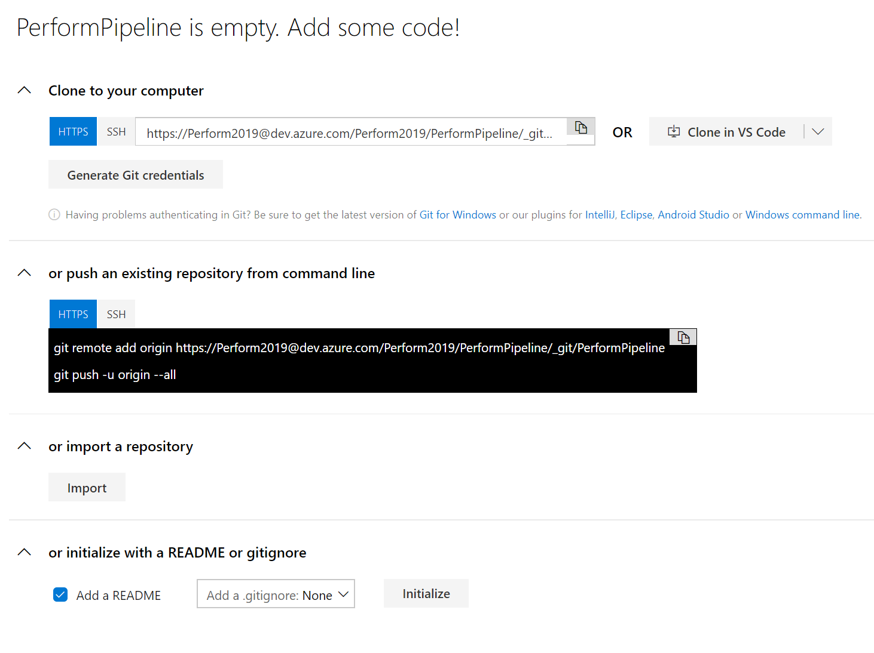
Getting Started: Import a Git Repository – step 1
Repos ->Import a repository

Slide 13
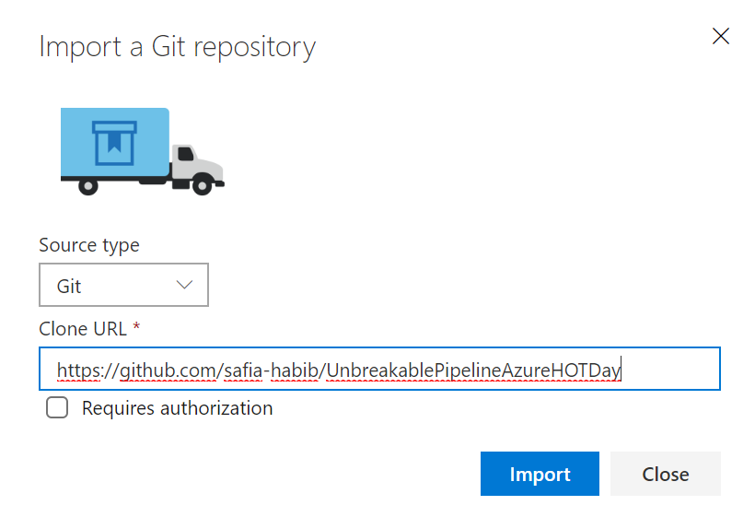
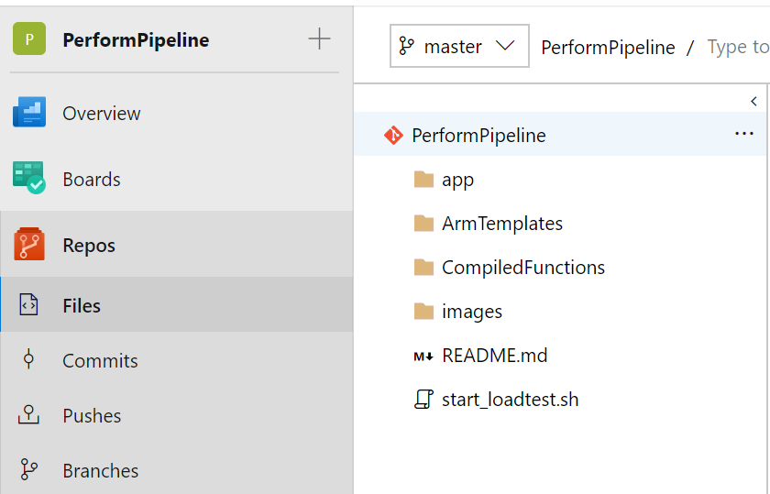
Getting Started: Import a Git Repository –step 2
Copy and Paste:
https://github.com/safia-habib/UnbreakablePipelineAzureHOTDay
Confirm the repository has been successfully imported

Slide 14
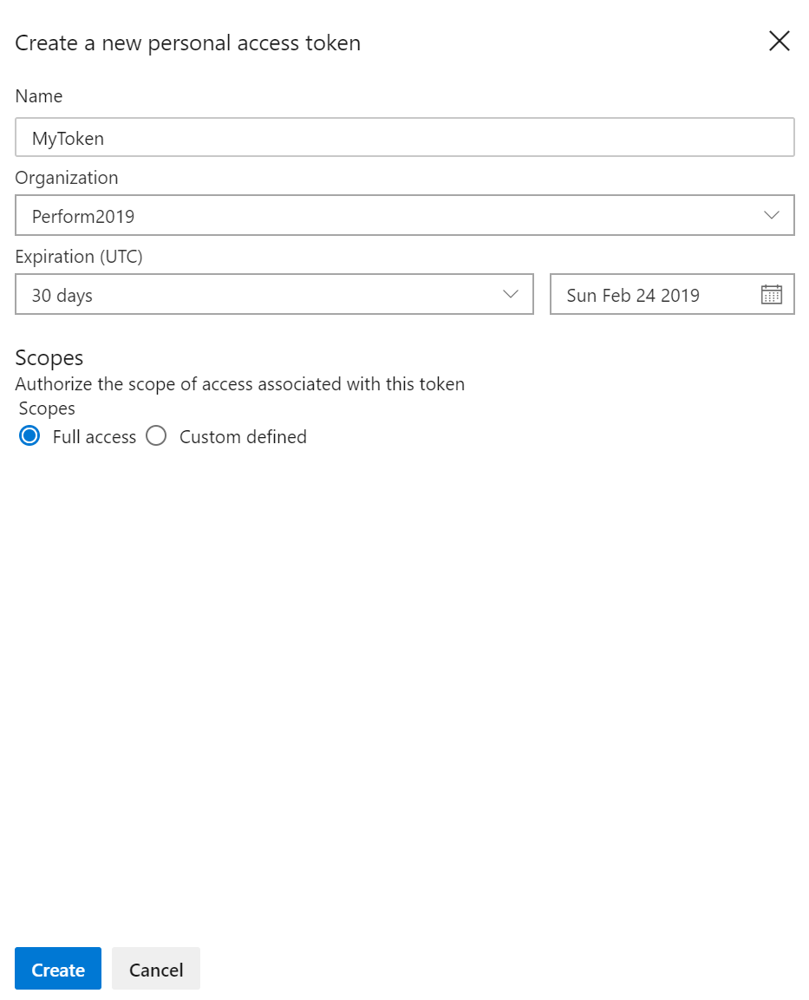
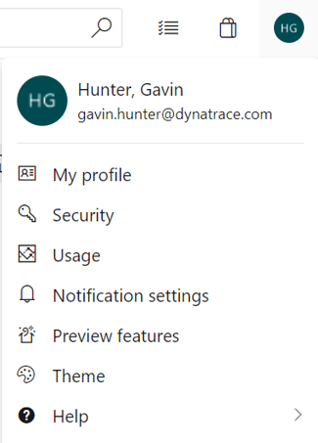
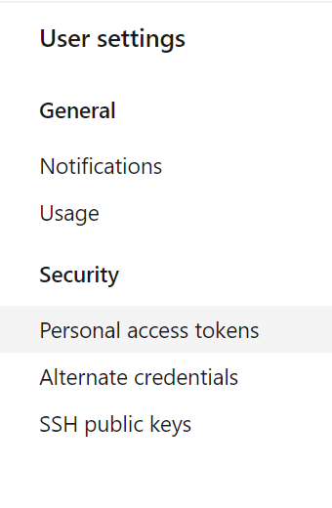
Getting Started: Create a new Personal Access Token
Create Personal Access Token
Copy your PAT
Paste into your Values table

Slide 15
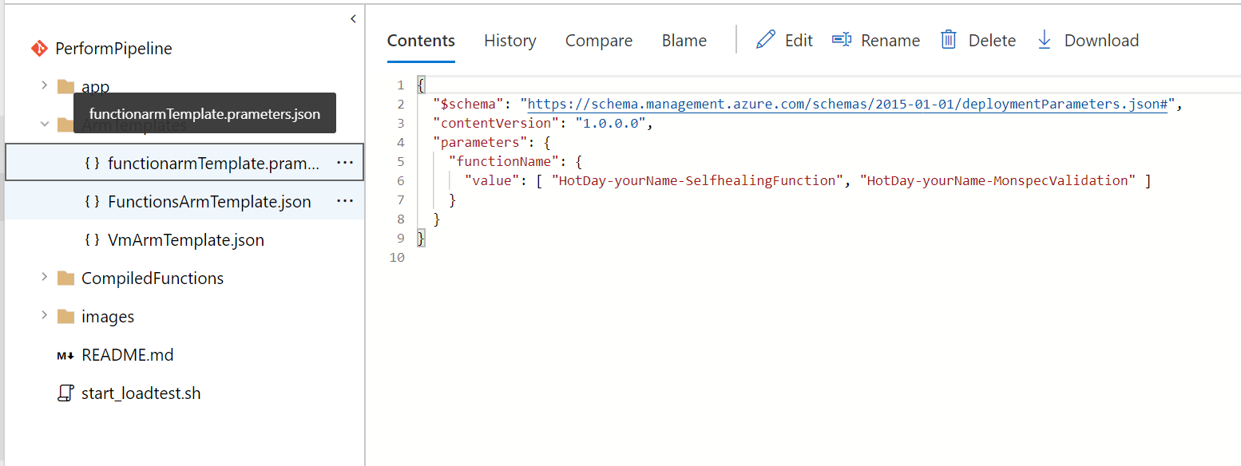
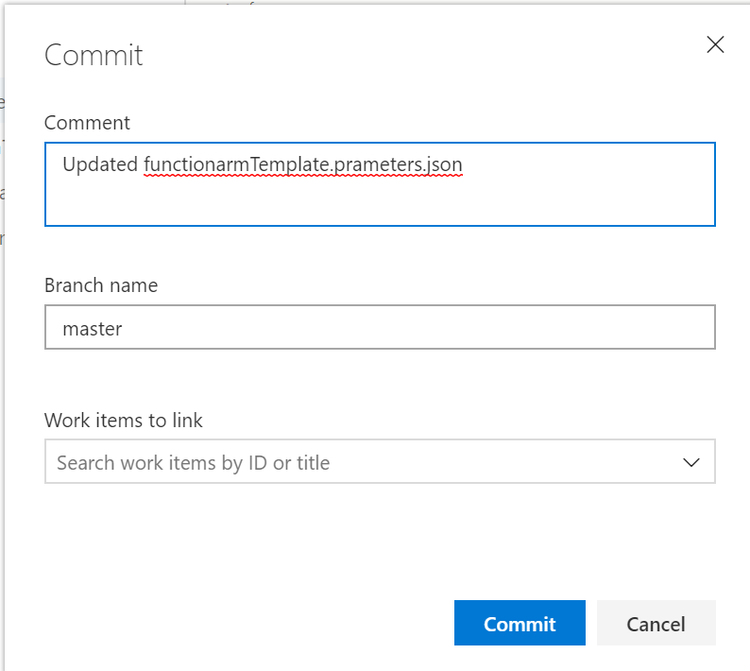
Getting Started: Update Function Names
HotDay-yourname-SelfhealingFunction
HotDay-yourname-MonspecValidation
Go to Repos ->Files->ArmTemplates
Choose ()functionarmTemplate.prameters.json
Edit Contents and update Function Names
Commit your changes

Slide 16
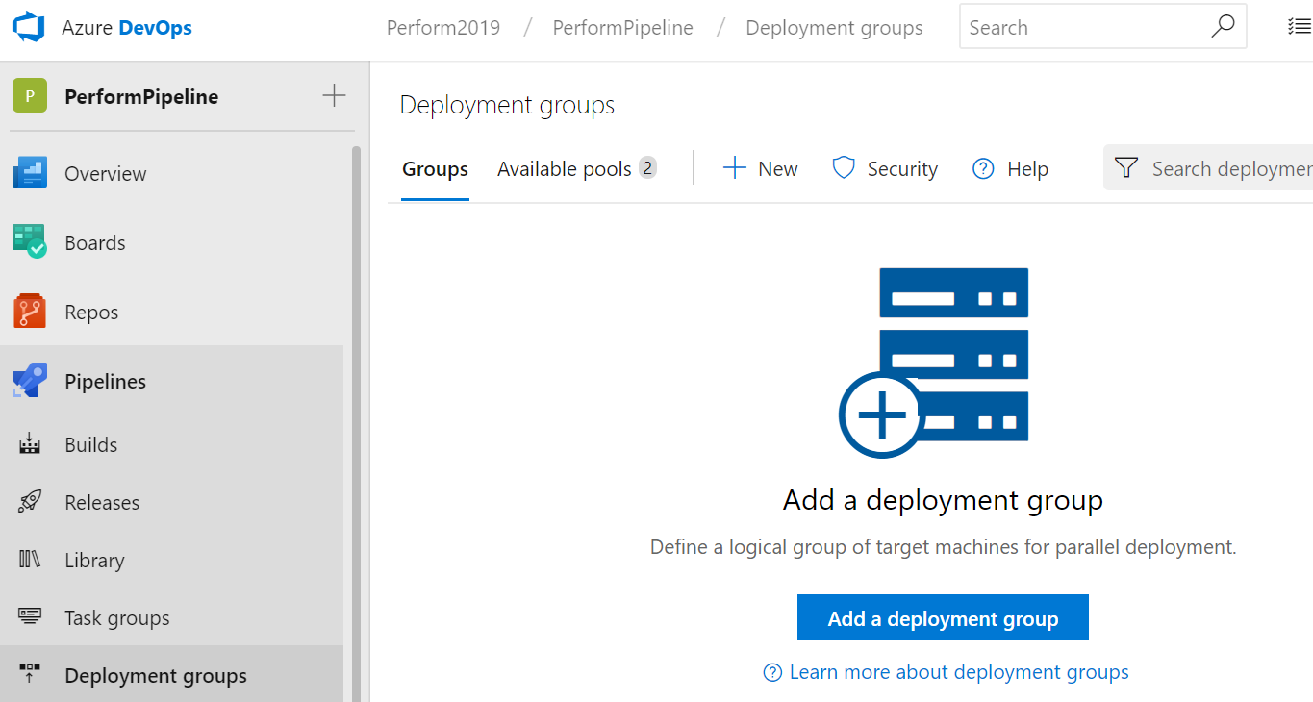
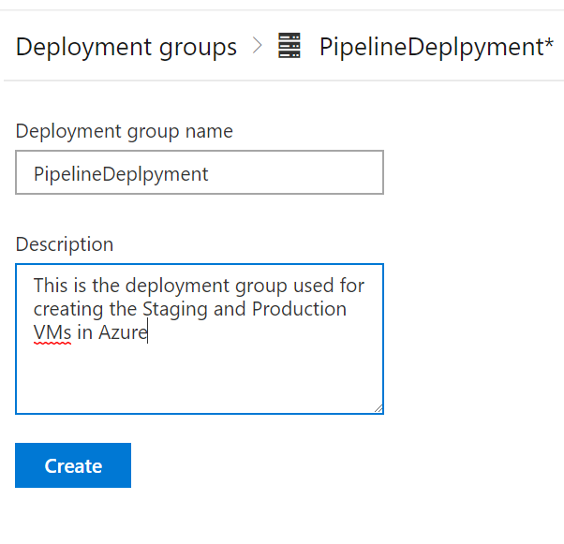
Getting Started: Create a Deployment Group
Go to Deployment Groups ->Add a deployment group
Name your Deployment group
Create

Slide 17
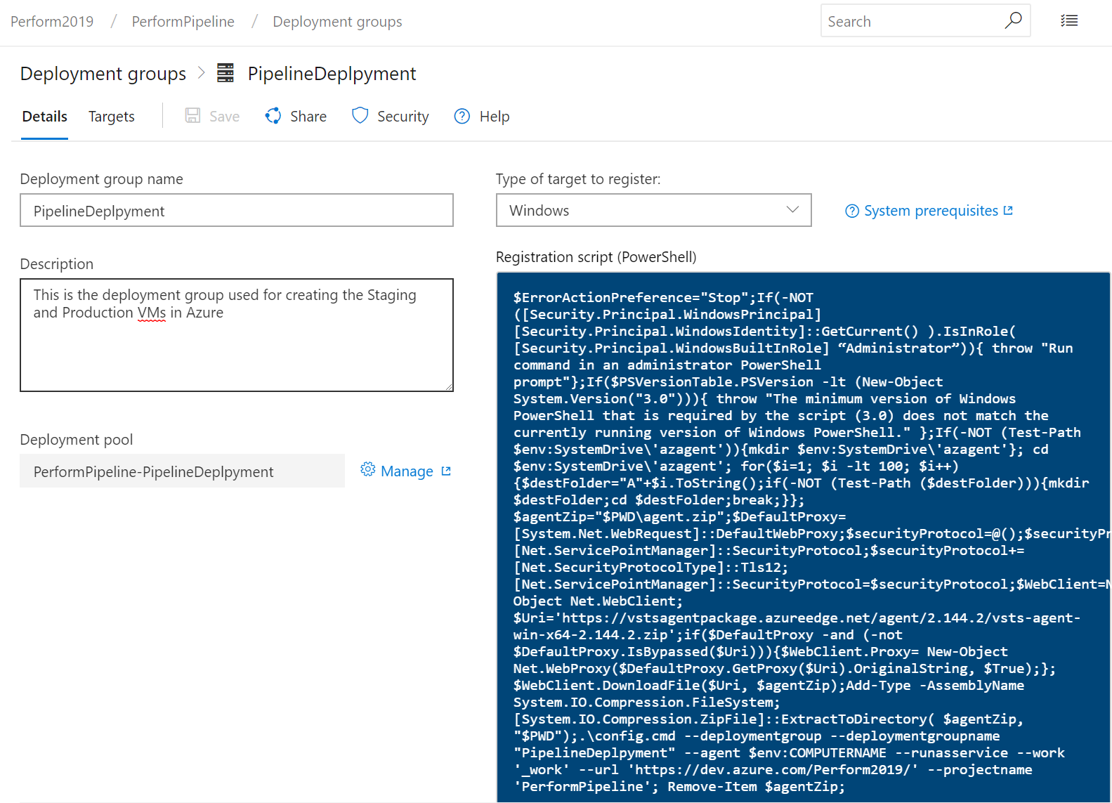
Getting Started: Results of New Deployment Group
No action required

Slide 18
Prevent in CI/CD VS Repair in PROD

Slide 19








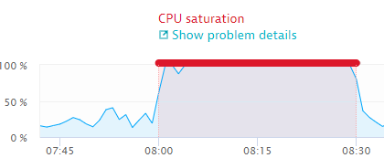
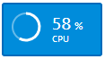
Add Key Metrics from Incidents to Quality Gates
2
Production
1
Code / Config Change
Staging
3
4
End Users
CI CD
CI CD
6
Add Metric to Quality Gate
5
Issue impacting SLAs

Slide 20
Use cases where we can “Shift Left”

Slide 21
Detect Change in Log Behavior
Use Cases
Are we logging too much? Did we turn on verbose logging by accident?
Metrics
Total Log Size
Number of Total and Critical Log Messages
How to Query?
E.g: Using CloudWatch Log Filters
aws logs put-metric-filter \
--log-group-name MyApp/access.log \
--filter-name EventCount \
--filter-pattern "" \
--metric-transformations \
metricName=MyAppEventCount,metricNamespace=MyNamespace,metricValue=1,defaultValue=0

Slide 22
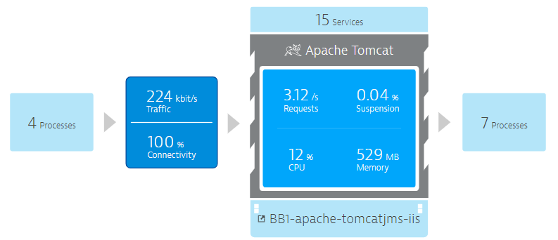
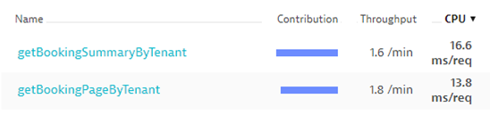
Detect Change in Resource Consumption
Use Cases
Bad coding leads to higher costs?
Metrics
Memory Usage
Bytes Sent/Received
Overall CPU
CPU per Transaction Type
How to query?
Some through CloudWatch API
Dynatrace Timeseries API

Slide 23
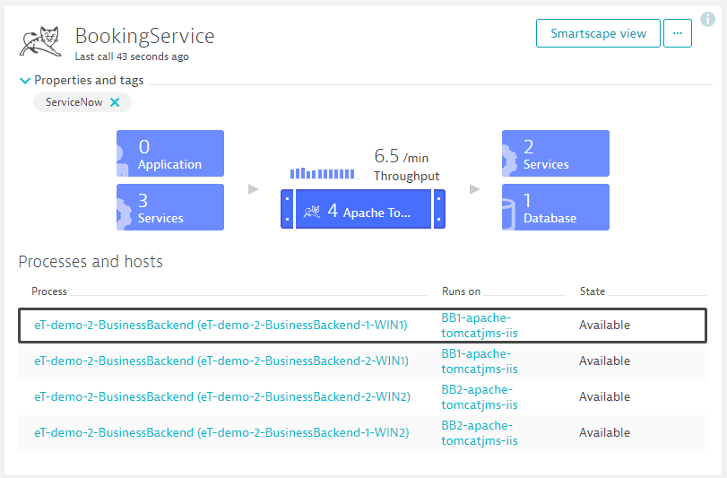
Detect Change in Dependencies
Use Cases
Do we have new dependencies? On Purpose?
Are we connecting to the services we are supposed to connect?
How many container instances are required?
Metrics
Number of incoming / outgoing dependencies
Number of instances running on
How to query?
Maybe CloudWatch API
Dynatrace SmartScape API

Slide 24
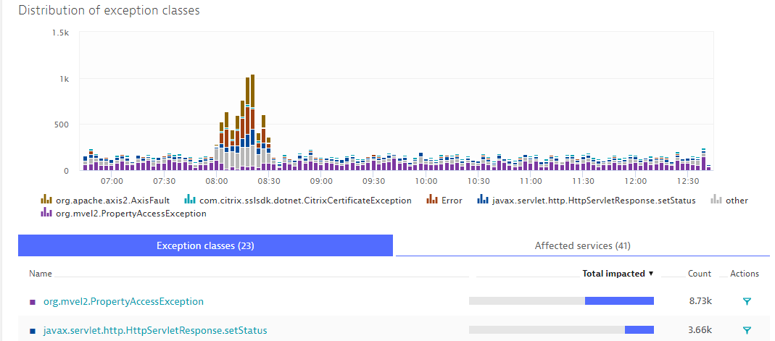
Detect Change in Application Exception Handling
Use Cases
Did we introduce new “hidden” exceptions?
Metrics
Total Exceptions
Exceptions by Class&Service
How to query?
Dynatrace Timeseries API

Slide 25
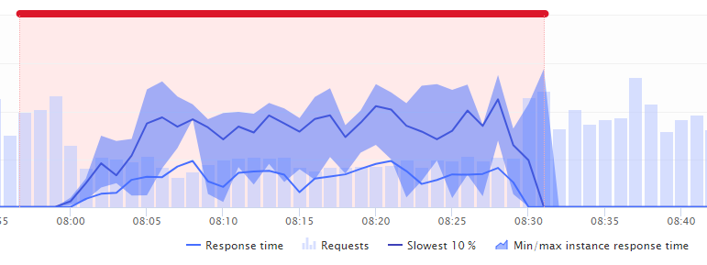
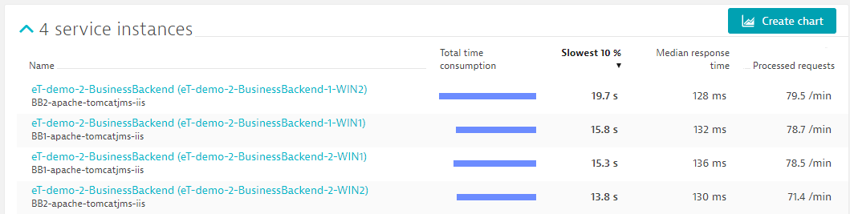
Detect Change in Performance Behavior
Use Case
Are we jeopardizing our SLAs?
Does load balancing work?
Difference between Canaries?
Metrics
Response Time (Percentiles)
Throughput & Perf per Instance / Canary
How to Query
Dynatrace Timeseries API
Dynatrace Smartscape API

Slide 26
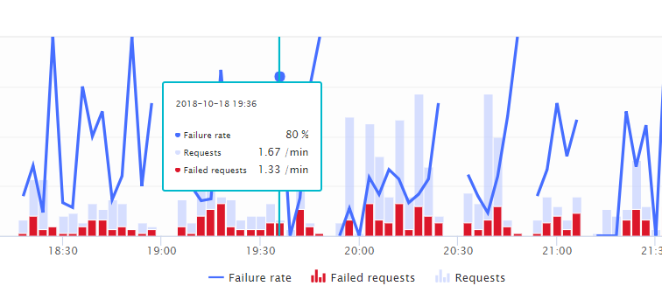
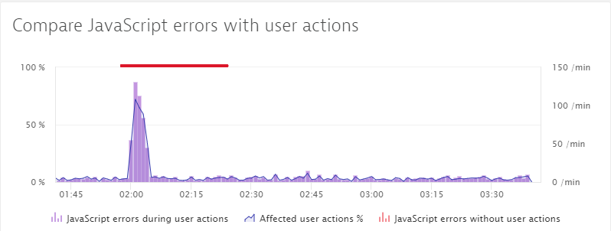
Detect Change in Error Behavior
Use Cases
New unexpected error conditions?
Metrics
HTTP Failure Rate
JavaScript Error Rate
Query through
RUM Solution
Dynatrace Timeseries API

Slide 27
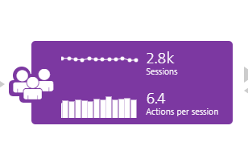
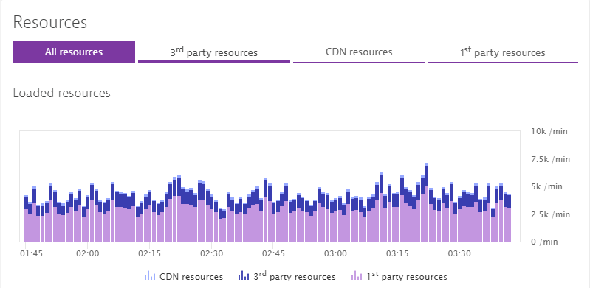
Detect Change in End User Scenarios
Use Cases
Average number of page requests per user increased?
How does this impact resource and capacity requirements?
Metrics
Number of User Interactions / Session
Page Sizes, Number of Resources
Query through
Real User Monitoring Solution
Dynatrace Timeseries API

Slide 28
List of Metrics we just discussed
Logging
Total Log Size
Number of Total and Critical Log Messages
Resources
Memory Usage
Bytes Sent/Received
Overall CPU
CPU per Transaction Type
Dependencies
Number of incoming / outgoing dependencies
Number of instances running on
Exceptions
Total Exceptions
Exceptions by Class&Service
Performance
Response Time (Percentiles)
Throughput & Perf per Instance
Errors
HTTP Failure Rate
JavaScript Error Rate
End User Scenarios
Number of User Interactions / Session
Page Sizes, Number of Resources

Slide 29
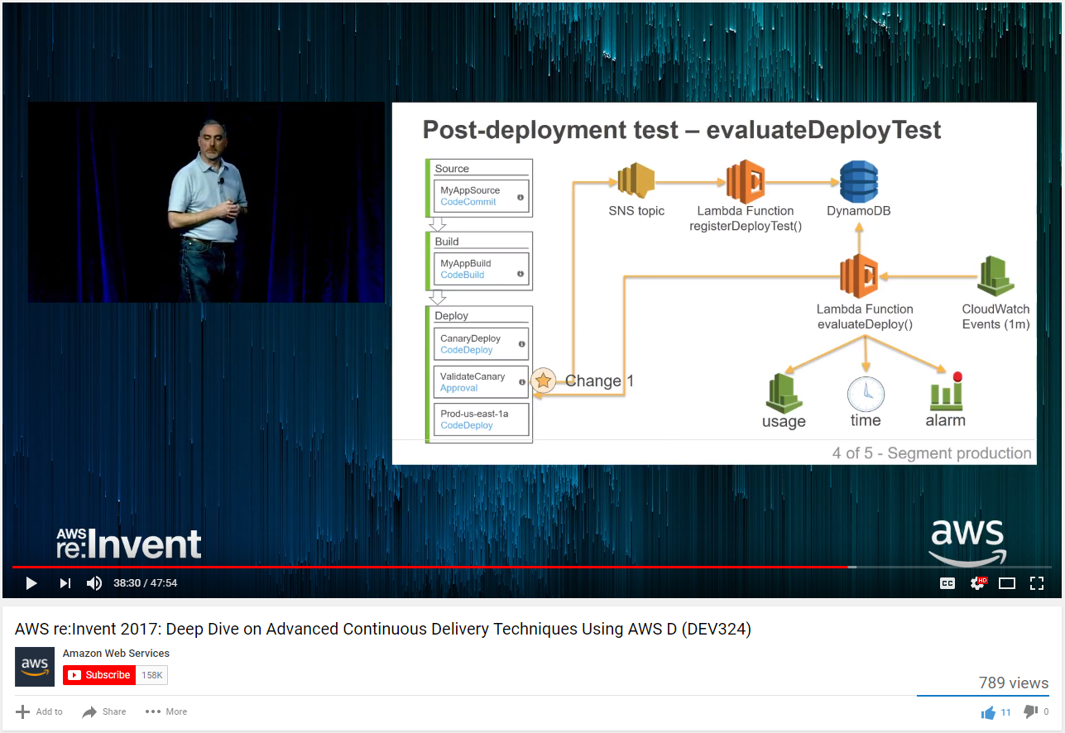
Inspiration from Curtis Bray (re:Invent 2017)

Slide 30
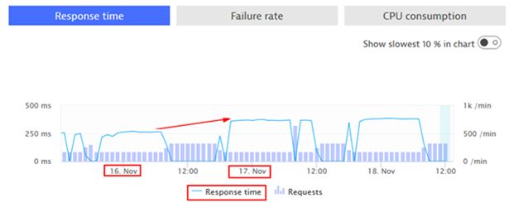
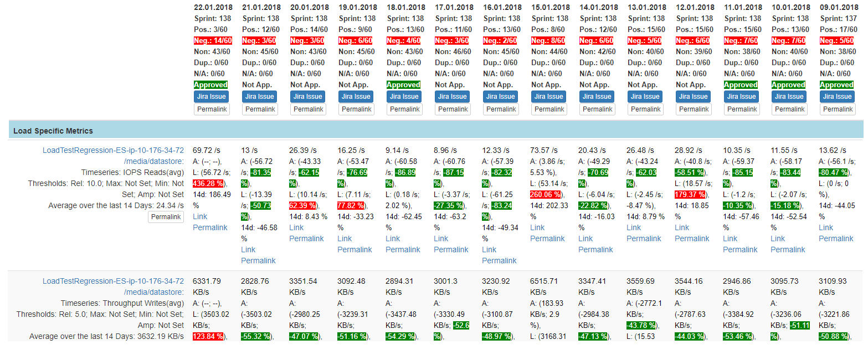
Inspiration from Thomas Steinmaurer @ Dynatrace
“Performance Signature” for Build Nov 16
“Performance Signature” for Build Nov 17
“Performance Signature” for every Build
“Multiple Metrics” compared to prev Timeframe
Simple Regression Detection
per Metric

Slide 31
“Build Validation / Monitoring as Code”
monspec.json
{
...
"perfsignature" : [
{
"timeseries" : "com.dynatrace.builtin:service.responsetime",
"aggregate" : “p90", // min, max, avg, sum, median, count, percentile
"validate" : "upper", // upper or lower
// "upperlimit" : 100, // Optional: Can be used to define a FIXED THRESHOLD
// "lowerlimit" : 50, // Optional: Can be used to define a FIXED THRESHOLD
},
{
"timeseries" : "com.dynatrace.builtin:service.failurerate",
"aggregate" : "avg"
},
{
"timeseries" : "com.dynatrace.builtin:service.requestspermin",
"aggregate" : "count",
"validate" : "lower"
},
{
"smartscape" : "toRelationships:calls",
"aggregate" : "count",
"upperlimit" : 1 // Validate that we only call to the one backend service and nowhere else!
}
],
Metrics: Which Metrics, Aggregation, Upper/Lower Boundaries
Dependencies: How many involved services?

Slide 32
Self Healing with Azure Functions

Slide 33
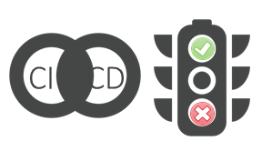
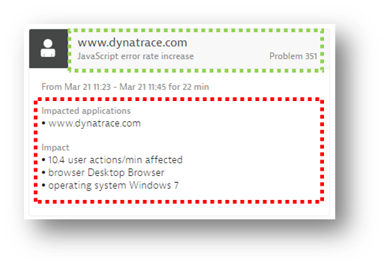



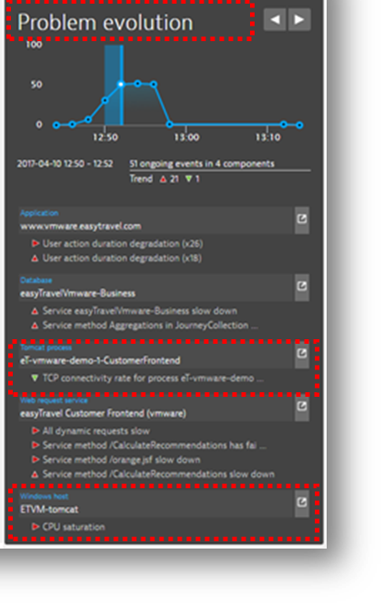












Self-Healing: Path to Autonomous Ops
How to escalate?
Inform #WebTeam about JavaScript Issue on IE
Push Status Update to inform our customers
Inform Support about potential incoming user complaints!
Auto Mitigate!
…
?
1
CPU Exhausted? Add a new service instance to distribute load!
2
Exhausted Connection Pool? Increase Pool Size!
3
Caused by Canary Release? Redirect Traffic to Main Canary!
Update Teams
?
Impact Mitigated?
2
?
Escalate
Still ongoing?
1

Slide 34
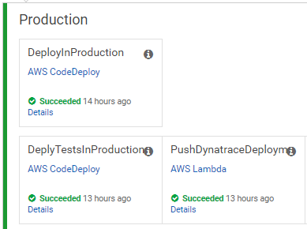
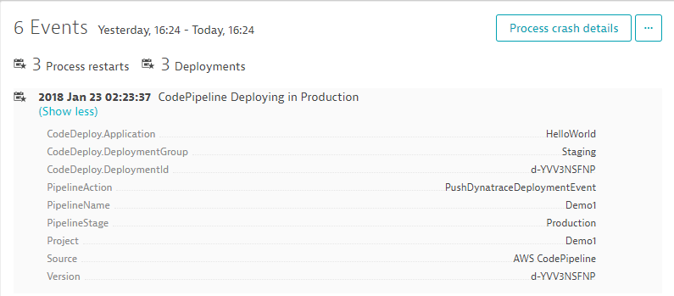
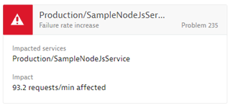
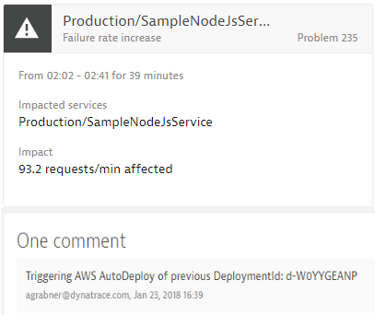


“Auto-Remediation as Code” triggered by Dynatrace
#1: Push Deployment Information, e.g: CodeDeploy DeploymentId
#3
Uses Dynatrace Events API
to pull CUSTOM_DEPLOYMENT events
#2: Calling Lambda via API Gateway
#4: Redeploy previous revision
Self Healing Serverless Function
#5: Push comment to Dynatrace

Slide 35
Creating the Unbreakable Pipeline In Azure DevOps (Formerly – VSTS)
Workshop 1: Add a Build Pipeline into Azure DevOps
Workshop 2: Deploy VMs/OneAgent - Functions into Azure
Workshop 3: Configure SelfHealing Function in Dynatrace / Deploy Build 1

Slide 36
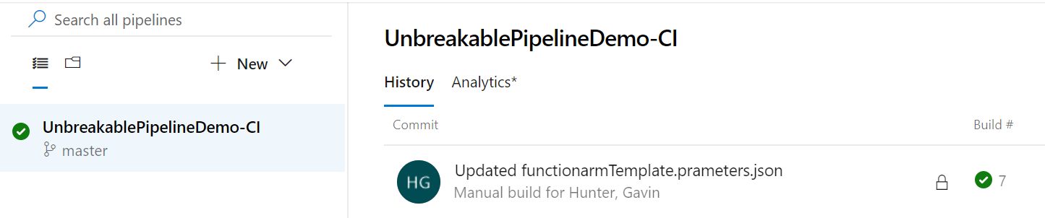
WORKSHOP 1 – CI Pipeline
Add a Build Pipeline into Azure DevOps
Create CI Build Pipeline in Azure DevOps
Import ‘UnbreakablePipelineDemo-CI

Slide 37
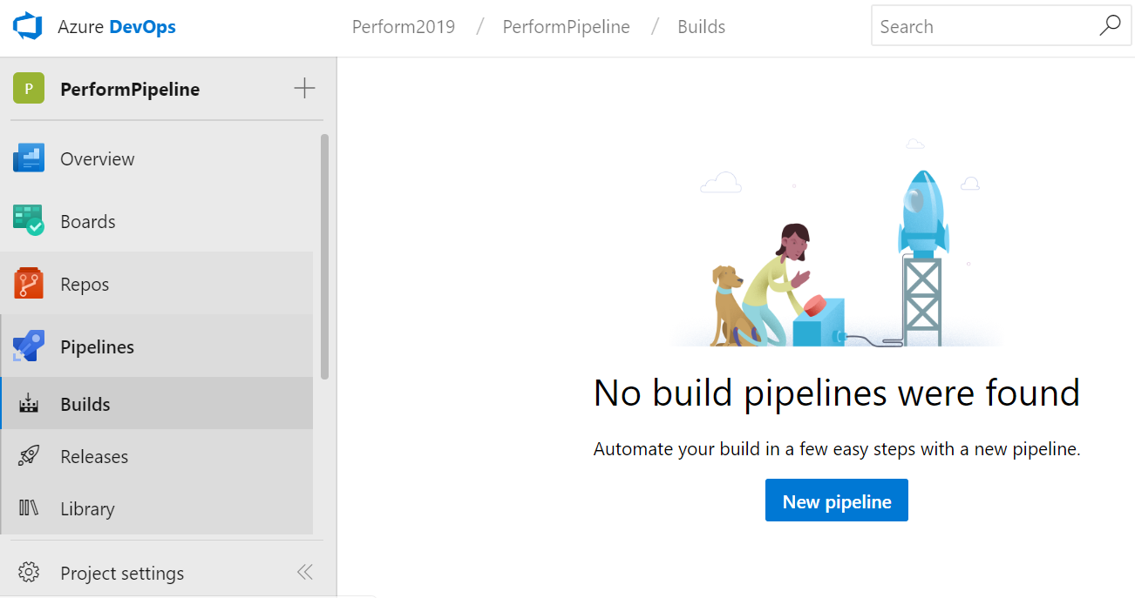
CI Pipeline: Create New Build Pipeline –step 1
Go to Pipelines->Builds
Choose ‘New pipeline’

Slide 38
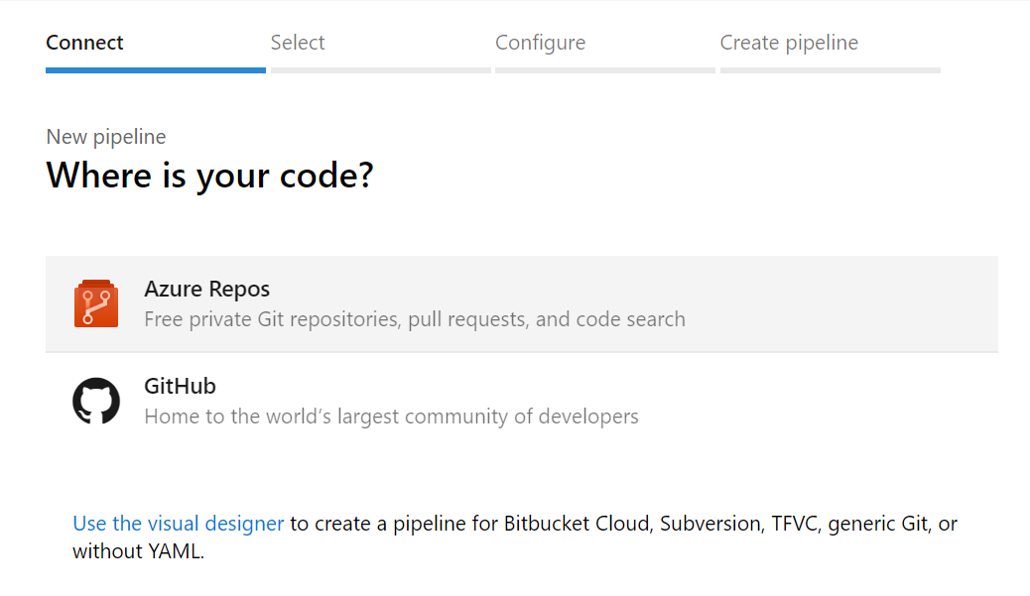

CI Pipeline : Create New Build Pipeline –step 2
1. Choose ‘Use the visual designer’
2. Keep Defaults and ‘Continue’

Slide 39



CI Pipeline : Create New Build Pipeline –step 3
2. Save the Build Pipeline
1. Start with an ‘Empty job’
Note: We will NOT use this Build Pipeline. This step must take place before an import can happen.

Slide 40




CI Pipeline : Import the UnbreakablePipeline-CI.json file
1. Got to Pipelines->Builds and Import a pipeline
3. Confirm you have the correct files chosen (CI) and hit ‘Import’
2. Select ‘UnbeakablePipelineDemo-CI.joson from your downloaded repo

Slide 41




CI Pipeline : Update the Build Pipeline –step 1
1. Rename the Build by removing the ‘–import’ from the end
2. Select ‘Hosted VS2017’

Slide 42


CI Pipeline : Update the Build Pipeline –step 2
Click on ‘Get sources’ and confirm that your Project is selected as the Repository
Save & Queue

Slide 43


CI Pipeline : Update the Build Pipeline –step 3
Hit ‘Save & queue’
Confirm Results are green

Slide 44

CI Pipeline : Results–step 4
Success!
Go back to Pipelines ->Builds and confirm results
Take note of the Build #

Slide 45

WORKSHOP 2 - CreateUtilities
Deploy VMs/OneAgent
Deploy Functions into Azure
Import Release Pipeline: ‘CreateUtililities’

Slide 46


CreateUtilities: Create a new Release Pipeline-step 1
Go back to Pipelines ->Releases and choose ‘New pipeline’
2. Choose ‘Start with an Empty Job’

Slide 47


CreateUtilities: Save your empty Release Pipeline-step 2
Save the Release but do not Release
Note: We will NOT use this Release Pipeline. This step must take place before an import can happen.

Slide 48




CreateUtilities: Import the ‘Create Utilities’ Release
Selct New->Import release pipeline
Navigate to your local Repo and choose ‘Create Utilies.json’ file
Confirm and hit OK

Slide 49



CreateUtilities : Recreate the Artifact-step 1
Select the Artifact on the right
Click on ‘Delete’
Confirm the deletion

Slide 50



CreateUtilities : Recreate the Artifact-step 2
Click on ‘Add an artifact’
Choose your source Build from the dropdown menu
Click on ‘Add’
Save

Slide 51

CreateUtilities: Update jobs and tasks-step 1
Select ‘CreateUtilities’ stage

Slide 52

CreateUtilities : Update jobs and tasks-step 2
From ‘Agent Job’ choose ‘Host VS2017’ from the dropdown for agent pool selection

Slide 53


CreateUtilities : Update jobs and tasks-step 3
Select ‘Update Resource Group action’ task on the left
Choose existing Resource Group or Type a name to create a new Resource Group
Select the region for your Resource Group (West US or Southeast)

Slide 54

CreateUtilities: Update jobs and tasks-step 4
Select the ‘Selfhealing function’ task on the left
Add your Azure subscription information on the right
Add the name of your Selfhealing function
Example:
HotDay-YourName-SelfhealingFunction

Slide 55

CreateUtilities : Update jobs and tasks-step 5
Select the ‘MonspecValidation function’ task on the left
Add your Azure subscription information on the right
Add the name of your MonspecValidation function
Example:
HotDay-YourName-MonspecValidation

Slide 56

CreateUtilities : Update jobs and tasks-step 6a
Select the ‘Update Azure Resource Group ’ action on the left
Scroll down and locate ‘Azure Pipelines/TFS service connection’ on the right
Select ‘NEW’

Slide 57

CreateUtilities: Update jobs and tasks-step 6b
This will create an authenticated connection to your Azure Resource Group
Provide a Name for this connection
Type, or paste, the URL of your DevOps URL
Verify Connection and confirm that it works
Hit ‘OK’
Example:
https://dev.azure.com/YourOrgName/

Slide 58

CreateUtilities: Update jobs and tasks-step 6c
Confirm that your new connection name is selected
d
d

Slide 59

CreateUtilities: Update jobs and tasks-step 7
Select ‘Deployment group job’ from the left
Use the dropdown menu on the right and select your Deployment Group
d
d

Slide 60

CreateUtilities: Update jobs and tasks-step 8
d
d
d
d
Select ‘Variables’ from the top menu
Update the value for your Dynatrace Tenant
Update the value for your Dynatrace Token
Save your settings
Note: These values should be saved in your table

Slide 61


CreateUtilities: Update jobs and tasks-step 9
Create a release by selecting ‘Release’ from the menu bar
Choose the latest Build number from the ‘version’ drop down selection
Hit ‘Create’

Slide 62
CreateUtilities: Verify Results-step 1
Confirm there are no red alerts across the Release Pipeline
Click on the Release-1 link to view release process

Slide 63


CreateUtilities: Verify Results-step 2
Success!
Hover over the progress box and select ‘Logs’
Watch the results until they complete and confirm that everything is green.

Slide 64

CreateUtilities: Confirmation of VMs in Dynatrace
Log into your Dynatrace Tenant
Navigate to ‘Hosts’ and confirm that you see a Production and Staging VM

Slide 65

WORKSHOP 3 – CD Pipeline
Configure SelfHealing Function in Dynatrace
Deploy Build 1
Build 1 is successful in Staging and so the Gate automatically pushes the update into Production

Slide 66

CD Pipeline : ‘Selfhealing’ Function URL
Log into Azure and locate the ‘Selfhealing’ function
Copy the URL and paste this into your values table

Slide 67

CD Pipeline: ‘MonspecValidation’ Function URL
Log into Azure and locate the ‘MonspecValidation’ function
Copy the URL and paste this into your values table

Slide 68

CD Pipeline: ‘MonspecValidation’ Function Token
Go to ‘Manage’ under the MonspecValidation function
Locate and copy the function key and paste this into your values table

Slide 69



CD Pipeline: Prepare Dynatrace for SelfHealing Function
Go to Dynatrace and navigate to Settings->Integration->Problem notifications->Setup Notification and Choose ‘Custom Integration’
Add the Webhook URL: ‘https://hotday-YourName-selfhealingfunction.azurewebsites.net?name=YourName’
Update the Custom payload:
{
"State":"{State}",
"ProblemID":"{ProblemID}",
"ProblemTitle":"{ProblemTitle}",
"PID":"{PID}",
"ImpactedEntities": {ImpactedEntities}
}
4. Test your connection and confirm success

Slide 70

CD Pipeline: Configure ‘SelfHealing’ Function parameters in Azure
Log into Azure and locate the ‘SelfHealing’ function
Add the following variables to your settings:
DT_TENANT_URL
DT_API_TOKEN
DT_VSTSURL
DT_VSTSPAT
NOTE: The values should be noted in your table

Slide 71


CD Pipeline: Import ‘UnbreakablePipelineDemo-CD.json’ File
Go to DevOps portal: Pipelines->Releases
Choose ‘Import release pipeline’ and choose the ‘UnbreakablePipeline-CD.json file from your repository

Slide 72

CD Pipeline: Recreate Pipeline Artifacts-step 1
Click on the Artifact on the left
Click ‘Delete’ on the right and confirm deletion

Slide 73

CD Pipeline: Recreate Pipeline Artifacts-step 2
Use the dropdown menu and select your Build pipeline
Click ‘Add’

Slide 74

CD Pipeline: Update Job and Tasks-step 1
Click on ‘Staging’

Slide 75
CD Pipeline: Application Release Pipeline Overview
Staging
Deploys the test app on Staging VM
Starts Loadtest against the test application
Pushes Deployment Event to Dynatrace
Production
Deploys the test app on Staging VM
Starts Loadtest against the test application
Pushes Deployment Event to Dynatrace

Slide 76

CD Pipeline: Update Job and Tasks-step 2
Select ‘Deployment group job’ on the left
Select your deployment group from the dropdown menu on the right
Type Staging in the ‘Required tags’ box

Slide 77


CD Pipeline: Update Job and Tasks-step 3
Select ‘Production’ from the Tasks menu
Type: Production in the ‘Required tags’ box

Slide 78

CD Pipeline: Update Job and Tasks-step 4
Select ‘Variables’ from the menu bar
Update the Dynatrace variables from your notes
NOTE: SimulateBuildNumber 1 - App Runs well in Both Staging and Production

Slide 79

CD Pipeline: Update Job and Tasks-step 5
Select the Gate icon from the pipeline and open the ‘Gates’ options
Click on ‘Invoke REST API:POST

Slide 80

CD Pipeline: Update Job and Tasks-step 6
Scroll down until you locate ‘Generic service connection’
Click on ‘Manage’ to create a new connection (This will open a new Tab)

Slide 81


CD Pipeline: Update Job and Tasks-step 7
Choose ‘Generic’ for a new connection type
Provide a name for your service connection
Paste your MonspecValidation URL copied from your notes and append /api/validatePerfSig to the end
Example:
https://hotday-YourName-monspecvalidation.azurewebsites.net/api/validatePerfSig

Slide 82

CD Pipeline: Update Job and Tasks-step 8
Add your new connection by selecting it from the dropdown

Slide 83

CD Pipeline: Update Job and Tasks-step 9
Update the Dynatrace API Token and Tenant from your notes table
Update the ‘MonspecValidation’ Function Token from your notes

Slide 84

CD Pipeline: Create the Release-step 1
Save all changes and Create a release

Slide 85

CD Pipeline: Create the Release-step 2
Select the latest Build version and hit ‘Create’

Slide 86


CD Pipeline: Verify the Release-step 1
Watch the progress of the release pipeline and verify everything succeeds

Slide 87

CD Pipeline: Verify the Release-step 2
Confirm that the deployment gate succeeded
NOTE: Build 1 is successful in Staging and so the Gate automatically pushes the update into Production

Slide 88

Automate Validation into Azure DevOps Pipeline with Azure Functions
Release Gate Validates Performance Signature
Current Implementation against static thresholds
Only two Metrics –
Response time
Error Rate
Validate Response Time
Static Threshold – 250ms
Validate Failure Rate
Static threshold – 0%

Slide 89


CD Pipeline: Verify the Release-step 3
Confirm that the Production deployment succeeds

Slide 90




CD Pipeline: Verify the Release-step 4
Success!
Confirm that you see deployment events in Dynatrace for both Staging and Production

Slide 91
Release Build 2
App starts failing in Staging (Shift Left -> Do not let the bad build to go to Production)

Slide 92

CD Pipeline: SimulateBuildNumber 2
Edit the UnbreakablePipeline CD Release and go to Variables
Change the ‘SimulateBuildNumber’ to 2
Save and Release this Build

Slide 93


CD Pipeline: Confirm the Release Fails
Success!
…well sort of
Build 2 generates a High Error Rate in Staging Environment by design
This Release should fail and therefore should NOT push into Production

Slide 94
Release Build 4
App runs well in Staging and starts failing in Production - To test Self Healing

Slide 95

CD Pipeline: SimulateBuildNumber 4
Edit the UnbreakablePipeline CD Release and go to Variables
Change the ‘SimulateBuildNumber’ to 4
Save and Release this Build

Slide 96


CD Pipeline: Confirm Release Succeeds
Confirm that the Post deployment gate succeeds
Confirm that the deployment into Production occurs

Slide 97

CD Pipeline: Dynatrace Problem Notification in Production
This Build was successful in Staging and pushed into Production but shortly afterwards problems occur
Go to Dynatrace->Problems to see any problems that are occurring
This Problem should trigger the Alert notification created earlier
The Alert should trigger the ‘SelfHealing’ function in Azure
The SelfHealing function should roll back to a previous, working, build

Slide 98


CD Pipeline: ‘SelfHealing’ Function at Work
Go to Azure->SelfHealing function and confirm that you see logs indicating that this function was invoked

Slide 99


CD Pipeline: ‘SelfHealing’ Function at Work
Success!
Confirm the redeploy is triggered into Production

Slide 100
We just built the Unbreakable Pipeline

Slide 101






Summary: Unbreakable Cloud Native Pipelines
1
2
Production
4
5
Staging
Approve Staging
3
Approve Production
CI CD
CI CD
CI CD
CI CD
Pushes deployment into Dynatrace entities
Compares builds and approves / rejects pipeline
Pushes deployment info into Dynatrace entities
Validates production and approves / rejects pipeline
Build #17
Build #18
Production
Executes auto-remediating actions e.g. roll-back

Slide 102
What’s Next? Remediation as Code

Slide 103


Crash -> Restart

Slide 104


Full or slow Disk -> Clean Up
$ find ./my_dir -mtime +10 -type f -delete

Slide 105


Bad Configuration Changes -> Revert

Slide 106

Bad Configuration Changes -> Revert
Change DNS Route!
Revert Change!

Slide 107



Low on Resources -> Scale Up

Slide 108

Overprovisioned after Drop in Traffic -> Scale Down

Slide 109

Blue vs Green -> Redirect Traffic
BLUE
GREEN

Slide 110

End User Impact -> Reverse Blue / Green
Deploy Blue
Back to Green

Slide 111
List of Remediation Action we discussed
Process Restarts
Resource (e.g: Disk) Cleanup
Revert Bad Configuration Changes
Scale Up
Scale Down
Blue vs Green Switching
Most teams currently execute these actions manually or semi-automated

